Slide 1
Funding vs. Student Achievement
The Miner League
Oct 2021

Slide 2
Why this is Important?
The reason we chose this topic for our project.
Education is the Future

Slide 3
The Data- National Assessment of Educational Progress (NAEP)
Phase 1-2
Phase 3
Phase 4
Phase 5
Phase 6
Phase 7
Develop/Create Assessment
Select the Participants
Distribute Materials
Administer Assessment
Score the Assessment
Analyze and Report Results
~2-5 years: Identify content and objectives for measurement.
~1 year: NAEP is given to a representative sample of students across the country
~8 months: Coordinate logistics to ensure assessment is prepared and delivered to administrators
~3 months: Participation takes approximately 90-120 minutes.
~4-6 months: Electronic image-processing scoring systems and trained staff.
~2-6 months: Analyze and develop online report.
Source: https://nces.ed.gov/nationsreportcard/assessment_process/

Slide 4
The Data
Test is administered every two years to students in grades 4, 8, and 12.
Our analysis looks at the 8th grade math and reading results from 2015 (most recent data available).

Slide 5
Research Question
Does the amount of funding provided to each state result in higher average test scores among students?
Does the amount of instructional expenditure per student result in higher average test scores among students?

Slide 6
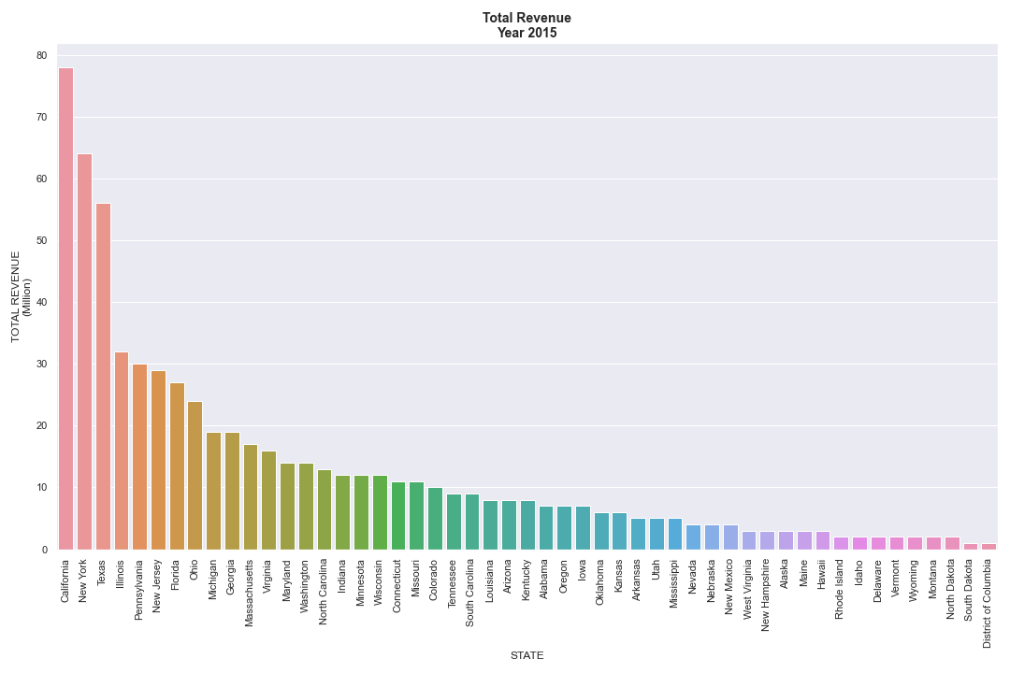
2015 Total Revenue

Slide 7
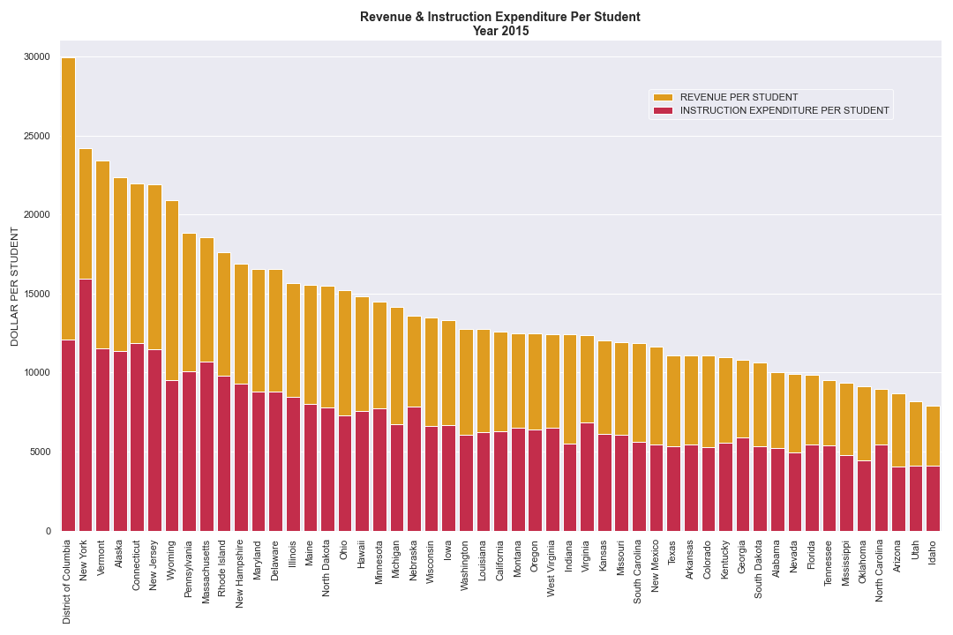
Total Revenue & Instruction Expenditure Per Student 2015

Slide 8
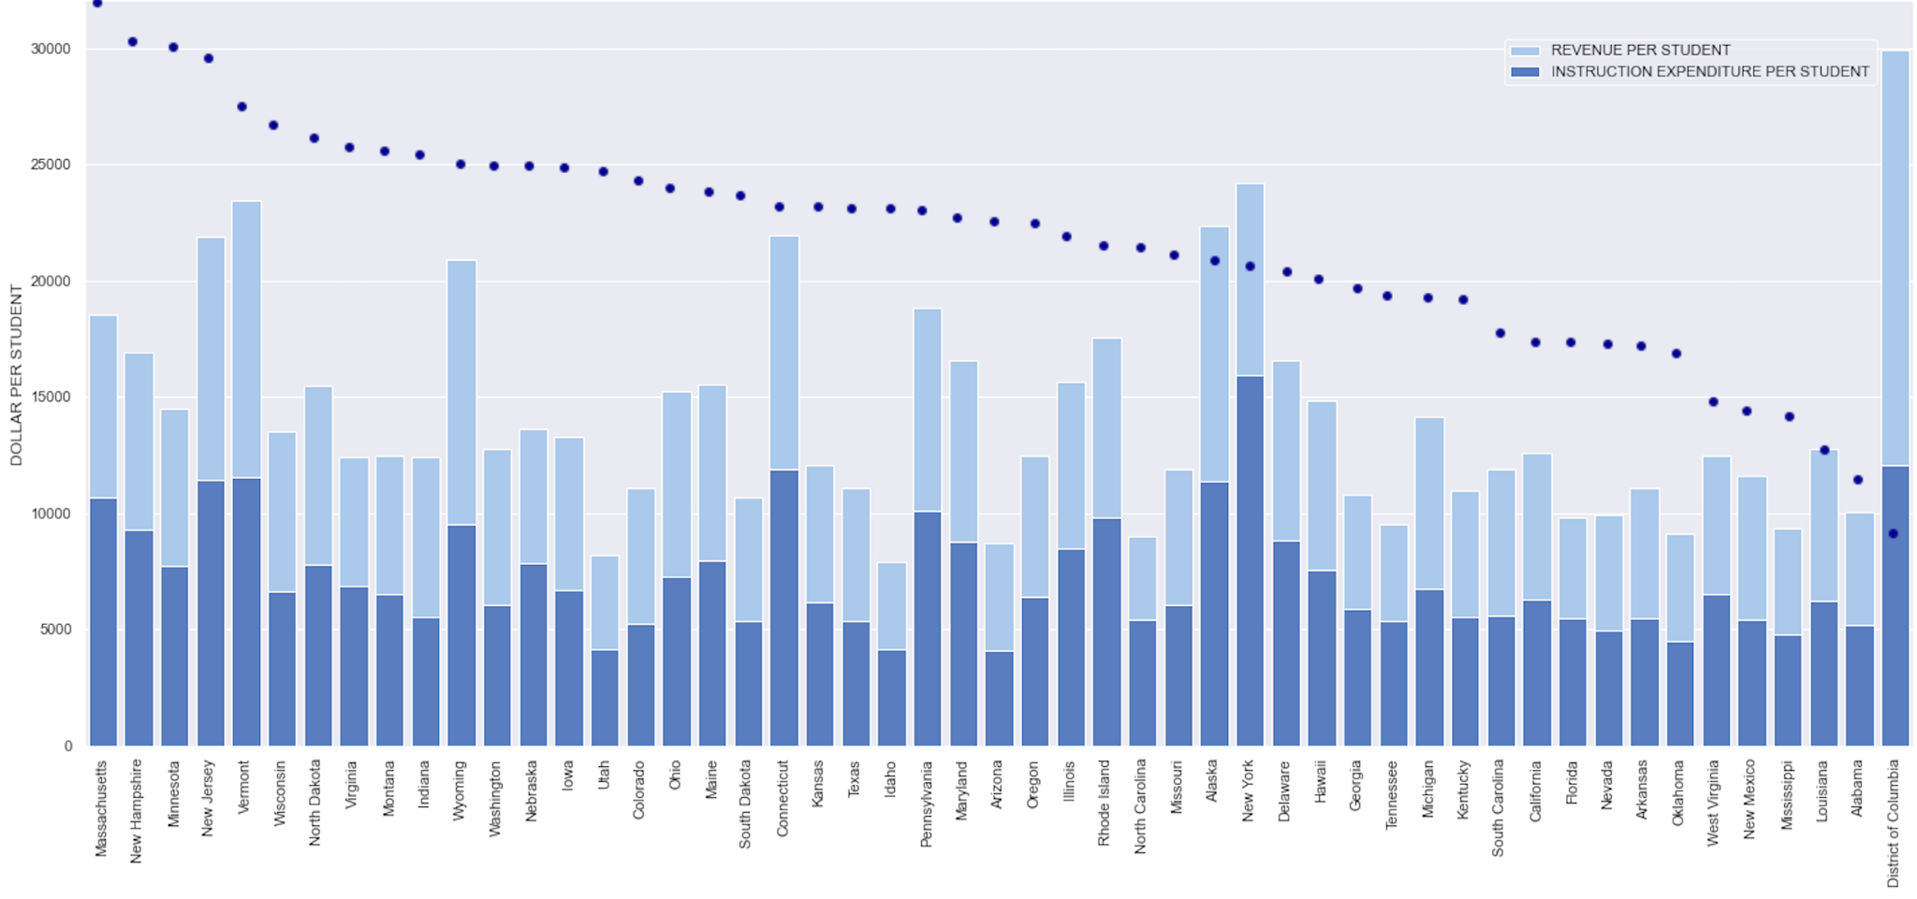
Instructional Expenditure vs Average Math Scores 2015
AVERAGE MATH SCORES
MA Math Avg Score: 297
DC Math Avg Score: 263

Slide 9
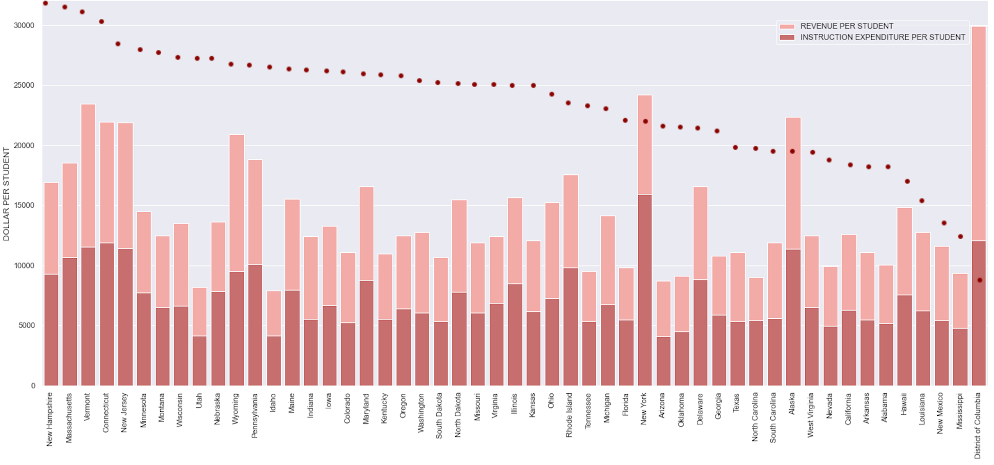
Instructional Expenditure vs Average Reading Scores 2015
AVERAGE READING SCORES
NH Reading Avg Score: 275
DC Reading Avg Score: 248

Slide 10
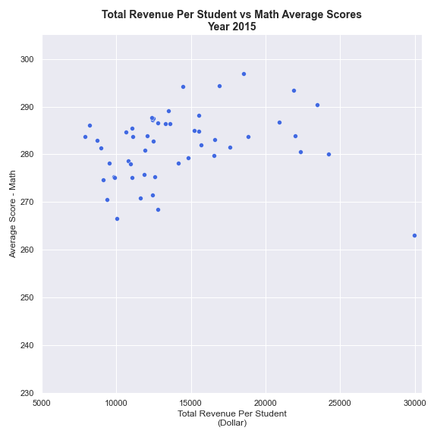
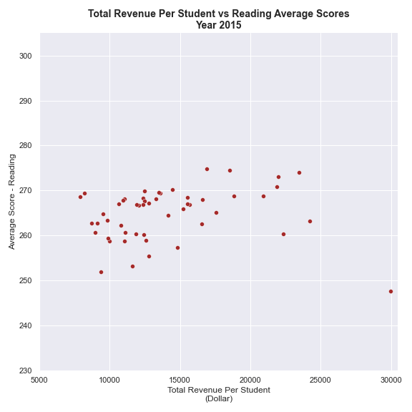
Analyze Year 2015
The r-value is 0.15325050360335443
The p-value is 0.2829781828330713
The r-value is 0.10859784086079192
The p-value is 0.44811301765377265

Slide 11
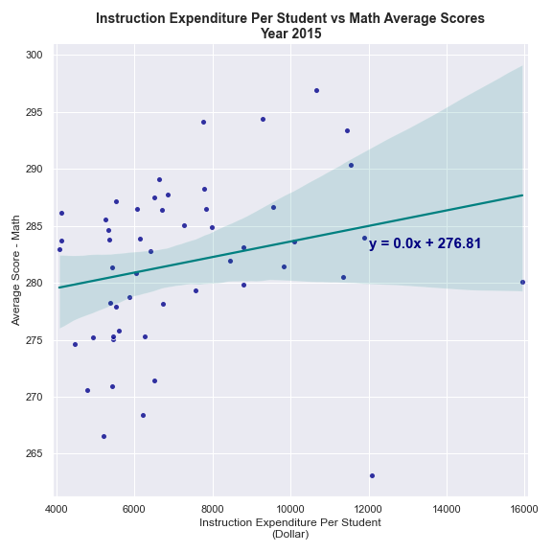
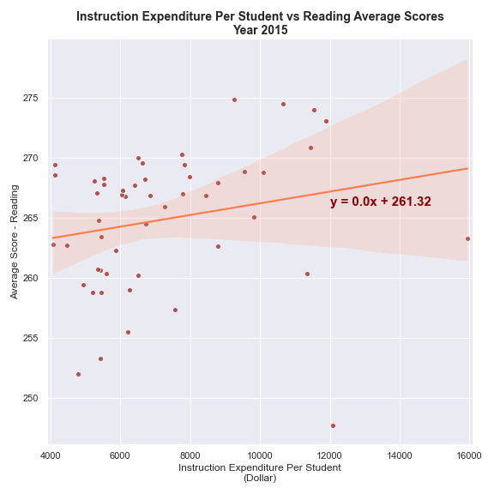
Analyze Year 2015
The r-value is 0.24051602931049249
The p-value is 0.8911160060745477
The r-value is 0.2138248898130834
The p-value is 0.13190184771034683

Slide 12
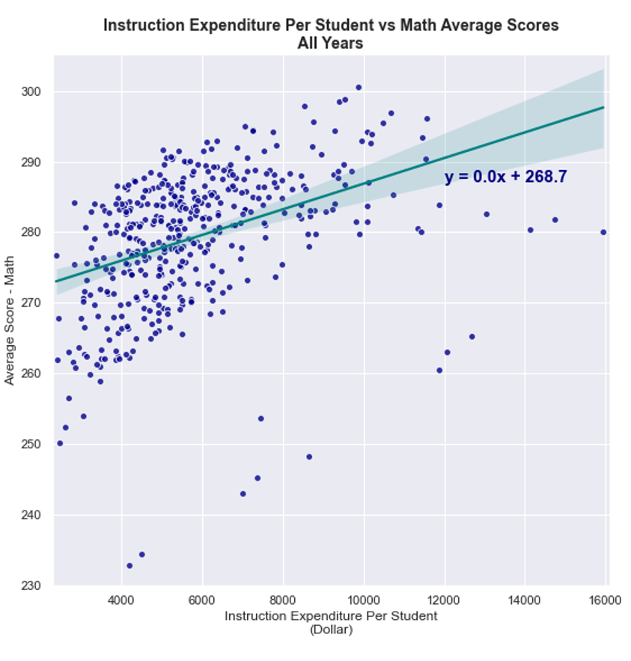
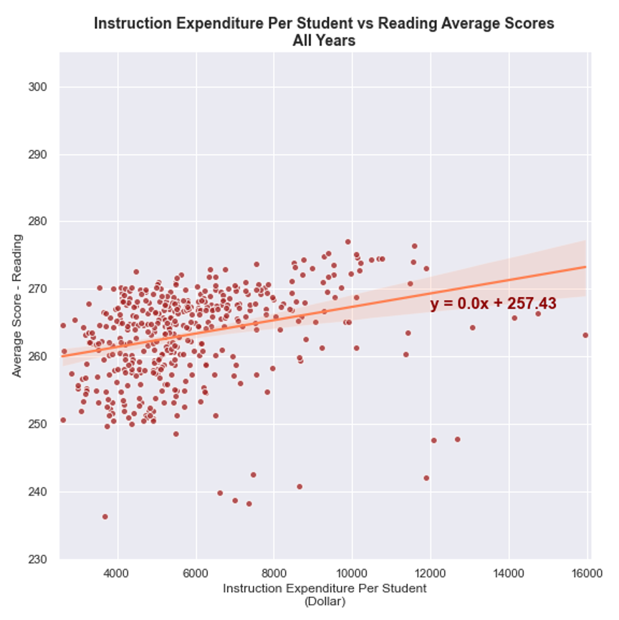
Analyze all years
r-value: 0.3985299032145992
p-value: 3.994740537525192e-18
r-value: 0.3026494206922508
p-value: 1.0942410123949781e-10

Slide 13
Summary/Conclusion
Analysis on Year 2015
Total Revenue & Instruction Expenditure by State
Comparison of Total Revenue per Student vs Math/Reading Scores
Comparison of Instruction Expenditure per Student vs Math/Reading Scores
Future analysis
Individual states
Individual school district allocation of spending
Collecting test data every year, instead of every 2 years
Demographics: age, gender, socioeconomic status, etc

